Slide 1
Grouping in the 21st Century Classroom
Ruth Valle
Phyllis Manning

Slide 2
Why Should You Group Your Students?
It is part of TEAM.
It is a way to differentiate instruction.
Students create in-depth projects.
Students take full advantage of technology.
Students collaborate - a necessary skill in the job market.
Students are prepared for a global society.

Slide 3
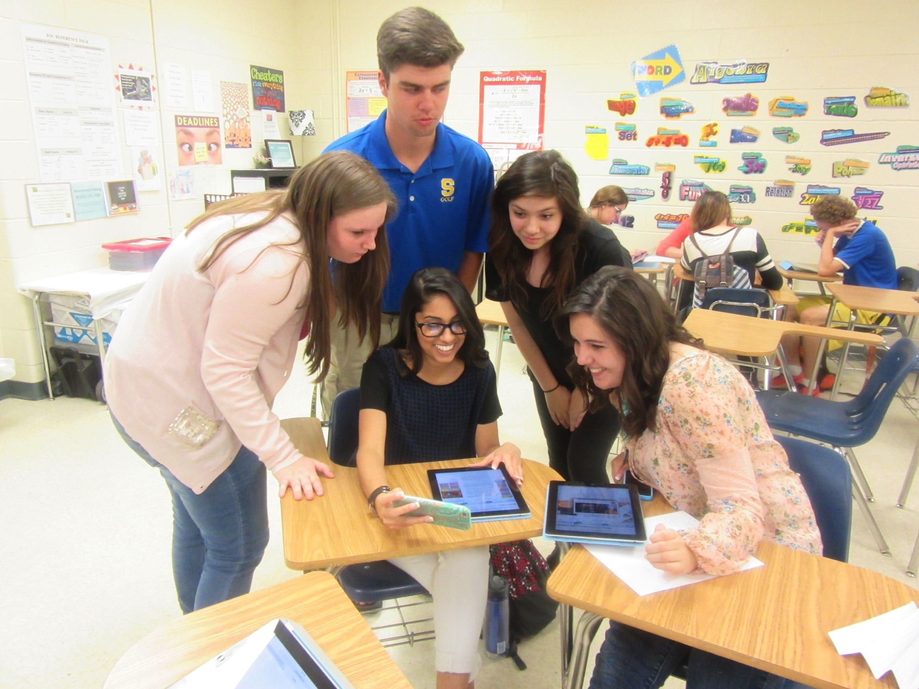
Cooperative Group Roles
Leader
Project Manager
Recorder
Presenter
Technology Expert
Researcher
http://www.dailyteachingtools.com/cooperative-learning-tasks.html

Slide 4
What is the 21st Century Teacher’s Role?
Facilitator
A mentor rather than an imparter of knowledge

Slide 5

A Multimedia Project Rubric

Slide 6
Grading Group Participation
https://www.asdk12.org/MiddleLink/Inter/mosaic/Coop_Placards.pdf

Slide 7
A 21st Century History Project
Timothy St. Pierre
Tyler Sloan

