Slide 1
Maximizing the Use of Your Promethean Board
http://edproconsultants.weebly.com
Phyllis Manning

Slide 2
Let’s Take a Survey
Kahoot.it

Slide 3
Not Just a Fancy Screen
Make basic templates for your interactive lessons – no need to reinvent the wheel daily.

Slide 4
Not Just a Fancy Screen

Slide 5
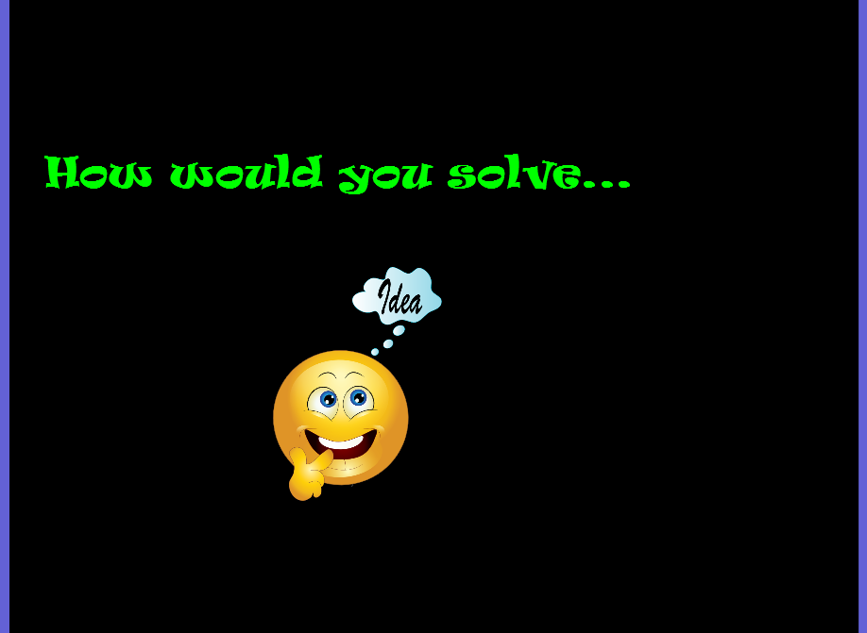
Not Just a Fancy Screen

Slide 6
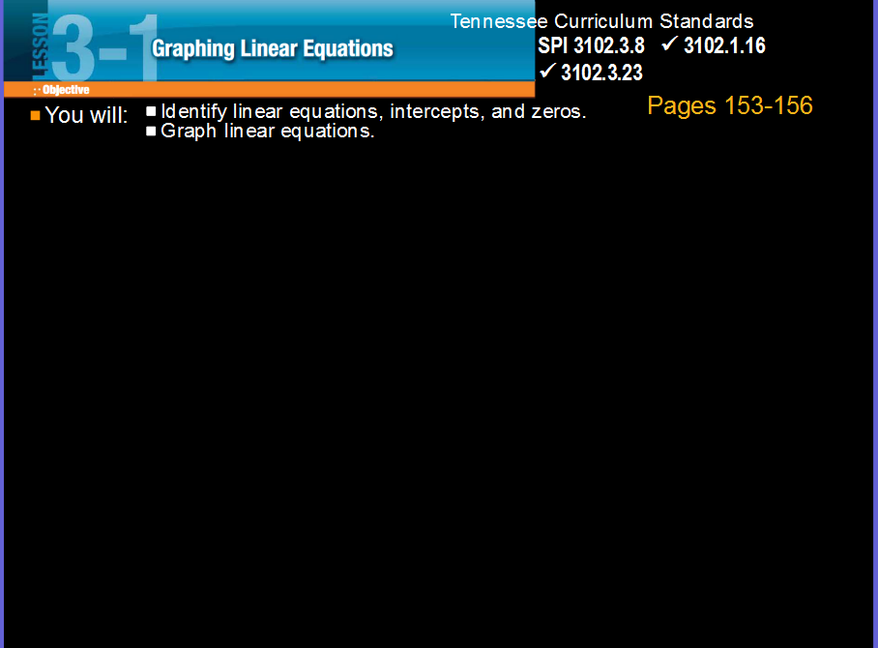
Not Just a Fancy Screen

Slide 7
Basic Tools
Do you know the basics?
Can you identify these tools?
If not, how do you know what they are?
(ActivInspire)

Slide 8
Tools and More
Utilize the tools of the board.
There are dozens of tools to explore and to personalize your toolbar.
(ActivInspire - Live)
-Tools
-More Tools
-Edit User Define Buttons

Slide 9
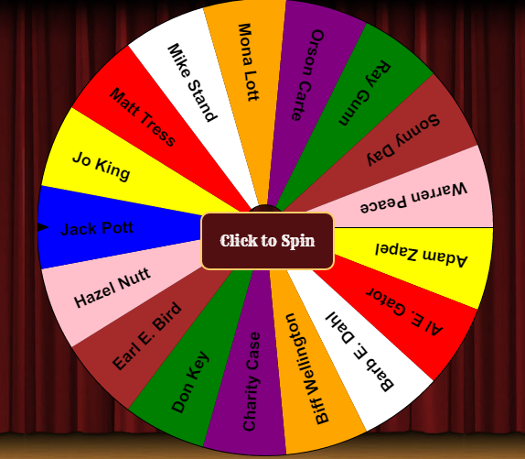
Cool Tools
Shapes
Duplicate Page
Camera
Desktop Annotate
Ticker Tape
Lock
Random Name Generator (classtools.net)
Magic Ink
Magic Revealer

Slide 10
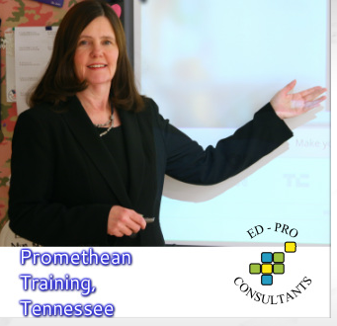
Would You Like to Know More?
Please leave your name and email on the sheet provided in the front of the room.

